Slide 1
Project Title : “Keylogger”
Domain : CYBERSECURITY
Team 5
STUDENT NAME:
SAGAR K A
SAIVARSHITH G R SUHAS S M
ID:
1SM24N068
1SM24N072
1SM24N199

Slide 2

Keylogger : Design a keylogger that discreetly captures and logs keystrokes on a target system to monitor user activity. The tool should operate in the background, store data securely, and support periodic reporting, emphasizing stealth, efficiency, and accuracy without detection by security software.
Problem Statement:

Slide 3
Introduction
A keylogger is a surveillance tool that records every keystroke made on a keyboard, often used to monitor user activity. In ethical hacking, it serves as a learning tool to understand security vulnerabilities and develop countermeasures.
This keylogger is designed for ethical hacking education, demonstrating how such tools function to enhance cybersecurity understanding.
It operates strictly within authorized test environments (e.g., virtual machines), ensuring compliance with legal and moral standards.

Slide 4

Key Components
Keyboard Listener: pynput.
Key Processor: Formats keys.
Log Writer: Appends timestamped.
Stealth Module: hide the log directory.

Slide 5
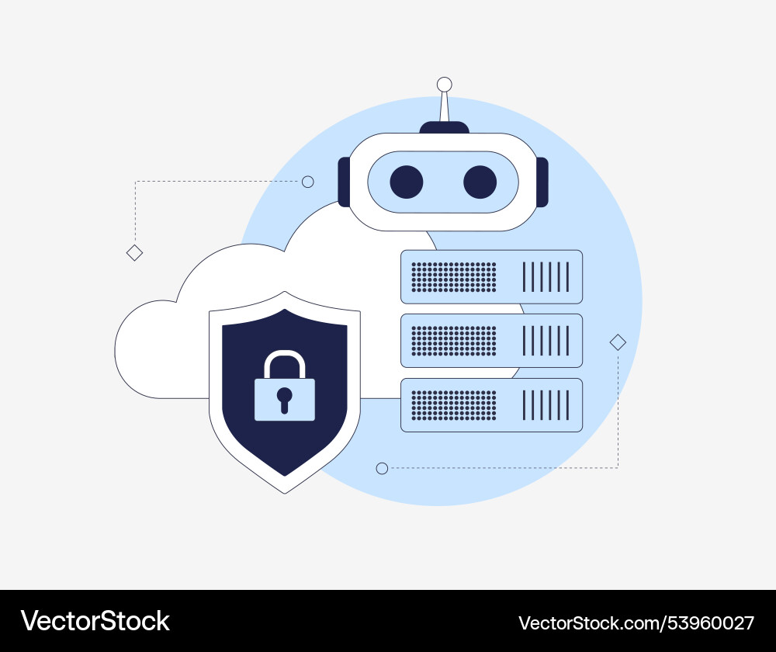
Working of Keylogger
Initialization: Initializes in a Windows VM, creating a hidden log directory and suppressing the console using ctypes.
Keystroke Capture: Uses pynput to capture all keystrokes, including special keys like [ENTER] and [SPACE].
Logging: Formats inputs and logs them with timestamps to a hidden file.
Stealth Operation: Operates in the background via to ensure stealth and minimal system impact.

Slide 6
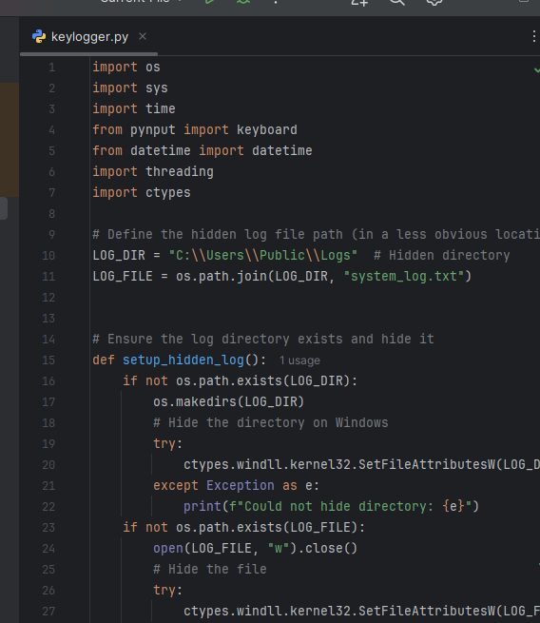
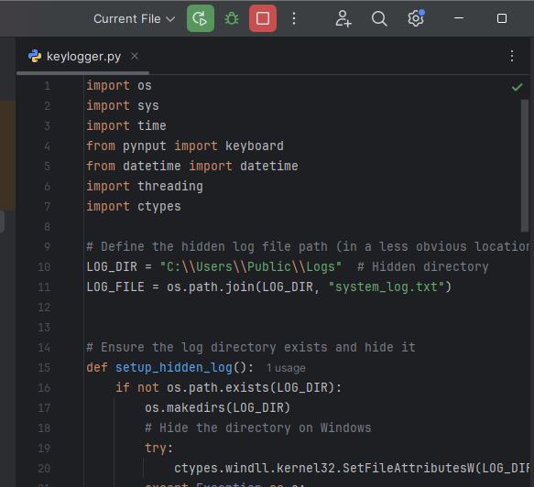
Snapshots of Implementation
Fig 1: Keylogger Program
Fig 2: Keylogger Program Running

Slide 7
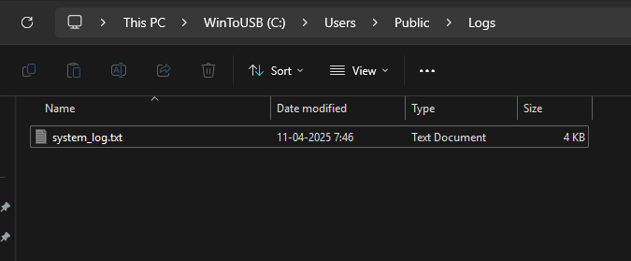
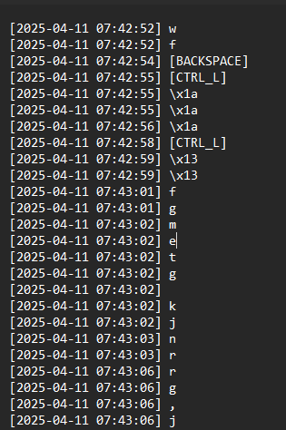
Stored in File Data
Fig 3: Output Stored Location
Fig 4: Stored values

Slide 8

Individual contribution to the project
Team Member’s Name | Contribution
SAGAR K A | System Setup and Stealth Mechanism
SAIVARSHITH G R | Keylogging and Processing
SUHAS S M | File Management and Threading Architecture

Slide 9
Conclusion
The Python-based keylogger demonstrates the fusion of cybersecurity concepts with programming, capturing keystrokes, threading, and file concealment techniques. It emphasizes responsible use in controlled environments. Despite antivirus detection, it offers insights into system vulnerabilities and covert monitoring. With future upgrades like encryption or remote logging, it remains a powerful tool for fostering secure coding and ethical cybersecurity practices.

Slide 10
Thank You

